Slide 1
Data Driven Analysis of The Silicon Valley Bank Collapse
Cody Meckes
DAT400
5/6/26

Slide 2
Project Overview
What caused the Silicon Valley Bank (SVB) Collapse?
Collapse Window (March 8th - 13th, 2023)
External Factors?
Internal Factors?
Loss in investor/customer confidence?
How did the failure impact:
Competing banks
Broader financial markets
Data Used (sourced from Kaggle):
SVB + competing banks stock data
Market Data (Interest Rates, Volatility Index)
https://www.kaggle.com/datasets/squidbob/2023-collapsed-banks-stock-prices-2017-2023?select=CS.csv
https://www.kaggle.com/datasets/sai14karthik/nasdq-dataset

Slide 3

Company Background/Predetermined Risk
Focused on venture capital and startups.
Heavy Investments in long-term securities.
United States Treasury Bonds
Interest Rates reduce bond value
Highly sensitive to changes in Interest Rates
Unrealized losses built up on SVB’s balance sheet
After assets lost value, bank could not meet customer withdrawal demands.

Slide 4
Project Flow – After Finding Stock/Market Data
Setup Repo + Connect to local folder
Setup Docker + Metabase
Python Data Cleaning/Sorting
Create PostgreSQL engine
Load Database into Datagrip
Setup Metabase dashboard

Slide 5
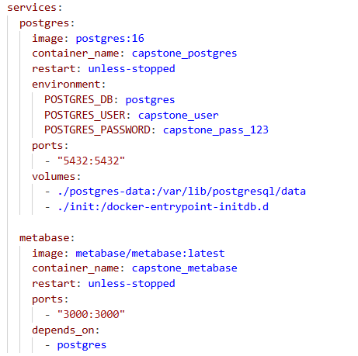
Python – Docker/Metabase Setup
Created the docker compose file.
Setup user, password, port, and volumes to keep running.
Created the /init folder to create the database.
Created the Metabase container.
This connects the database through Python, Datagrip, and a browser for Metabase.
Notes:
“This Docker Compose file created my local analytics environment by running PostgreSQL for data storage and Metabase for visualization, while mapping the ports so I could connect through Python, DataGrip, and the browser.”

Slide 6
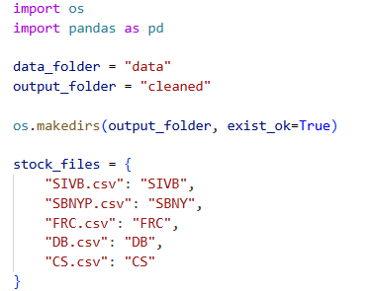
Python – Data Cleaning
Sets up folder for data pipeline.
Imported pandas and os to handle processing.
Defined folders for data and cleaned data.
Maps files to tickers.
Notes:
I import the necessary libraries, define where my raw and cleaned data will be stored, and ensure the output folder exists. Then I create a dictionary that maps each CSV file to its corresponding ticker symbol, which allows me to label each dataset consistently during processing.”

Slide 7
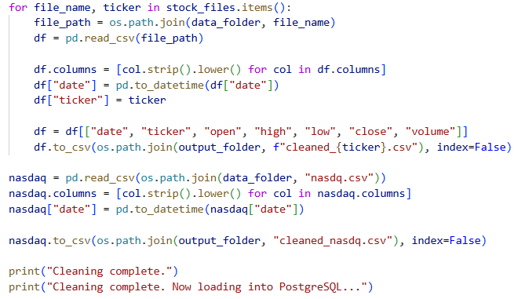
Python – Data Cleaning
Reads all csv files.
Cleans/Standardizes columns (ex. Date).
Adds a ticker columns for each dataset.
Keeps relevant columns only.
Saves cleaned files to output folder.
Notes:
“This is the core data cleaning step. I loop through each stock dataset, read it into Python, and standardize the structure by cleaning column names and converting the date field. I also add a ticker column so all datasets can later be combined into a single table. Then I select only the relevant fields for analysis and export cleaned versions of each dataset. I apply the same process to the macroeconomic data to ensure consistency across all sources.”

Slide 8
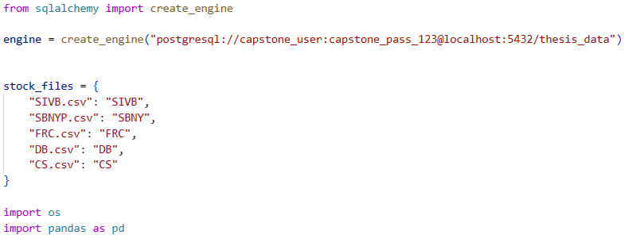
Python – PostgreSQL
Imports SQLAlchemy
Creates the database engine.
Allows communication with Docker.
Stores data after cleaning.
Notes:
I use SQLAlchemy to create an engine that allows Python to communicate directly with the database running in Docker. The connection string includes the database credentials, port, and database name. This step is important because it allows me to move from data cleaning into structured storage and SQL-based analysis.”

Slide 9
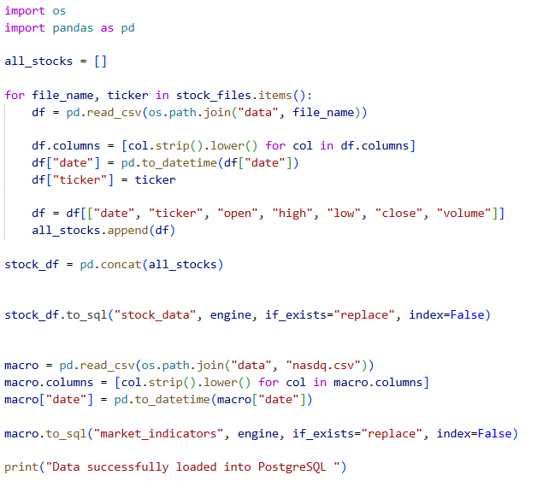
Python – PostgreSQL
Creates an all_stocks list.
Loops through each file.
Combines all datasets
Loads into PostgreSQL (stock_df.to_sql)
Processes Market data.
Nasdaq data
Loads market data into PostgreSQL.
Saves as table (market_indicators)
Notes:
I loop through each stock dataset again, clean them consistently, and store them in a list. Then I use pandas to concatenate all datasets into a single dataframe, which allows me to analyze all banks together. After that, I load the data into PostgreSQL as a structured table called stock_data. I repeat a similar process for the macroeconomic data and store it in a separate table called market_indicators. At this point, the data is fully structured and ready for SQL analysis and visualization.”

Slide 10
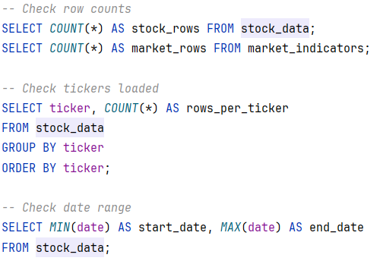

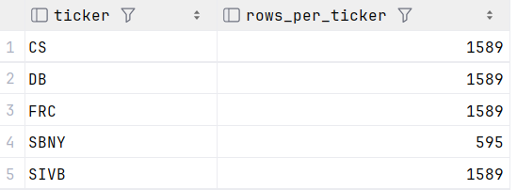
DataGrip – Data/Sanity Check
Checked that data successfully loaded into SQL
Tested SQL queries before trying out in Metabase.
Just a final sanity check.
Data successfully loaded.

Slide 11
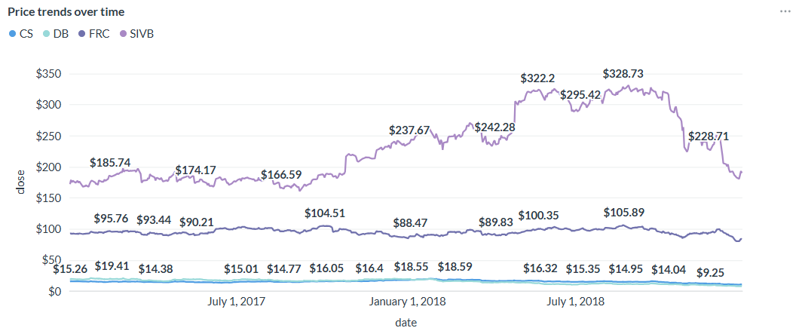
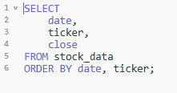
Metabase Results – Price Trends Over Time
Before Collapse Window
Stock trends aligned with competitors
No early signs of divergence
Sharp decline began around collapse window
Chart plots
Credit Suisse CS and Deutsche Bank DB (International POV)
First Republic Bank FRC and Silicon Valley Bank SIVB (Regional POV).
Query used in Metabase to create visual

Slide 12
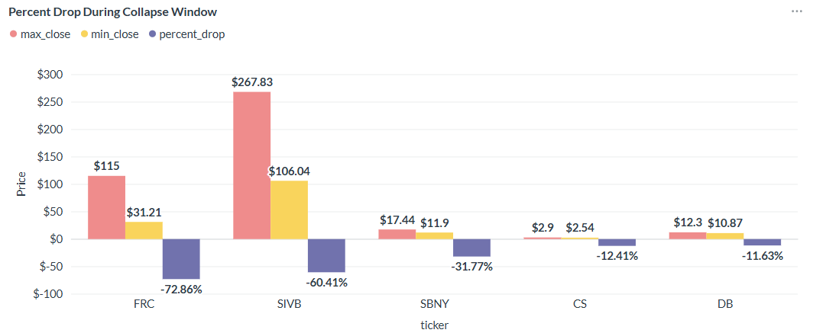
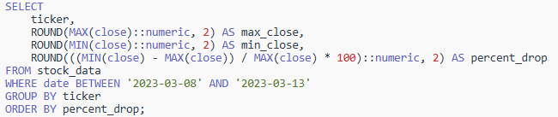
Metabase Results - % Drop During Collapse Window
Quantifies the Percentage Drop During collapse window of each bank.
SVB has the one of the largest percentage drops.
Possible case of contagion effect from SVB’s collapse.
Calculated by taking percentage change from highest and lowest closing price per ticker.
Query used in Metabase to create visual

Slide 13
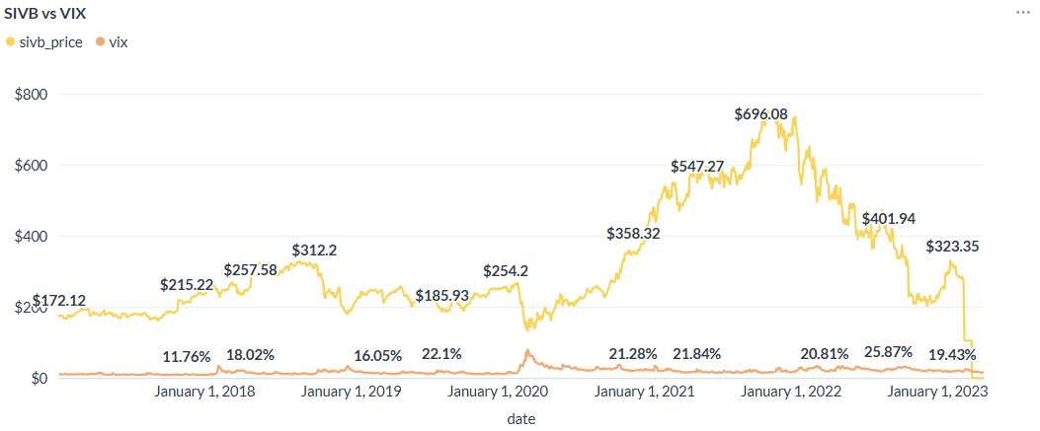
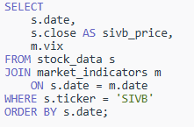
Metabase Results – SVB vs VIX
Chart compares SVB’s stock price to Volatility Index of the market.
As SVB rapidly declines, market volatility stays relatively normal.
Shows that SVB’s collapse was more region/firm specific.
Chart compares SVB’s price to VIX percentage of expected annual volatility.
Query used in Metabase to create visual

Slide 14
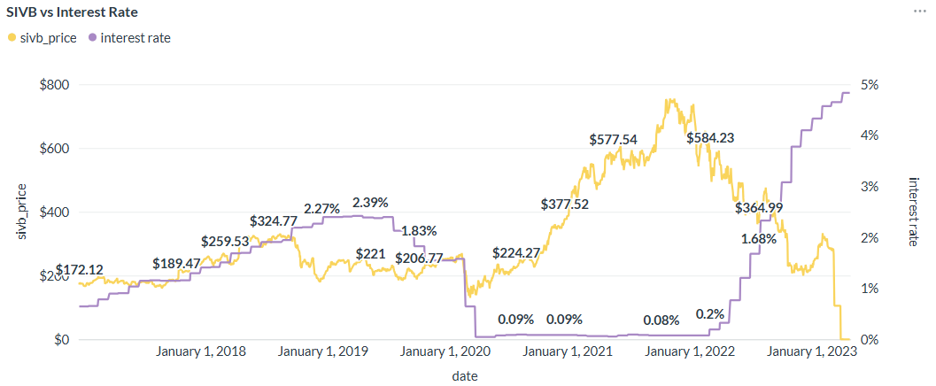
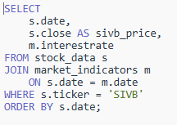
Metabase Results – SVB vs Interest Rates
Chart compares SVB’s price to federal interest rates over a 5-year period.
Interest rates spike in late 2022 – early 2023.
During that time, SVB’s price plumets.
Shows that SVB could not handle rising interest rates.
Majority of the Bank’s investments were in US Treasury Bonds. (Highly sensitive to interest rates)
Query used in Metabase to create visual

Slide 15
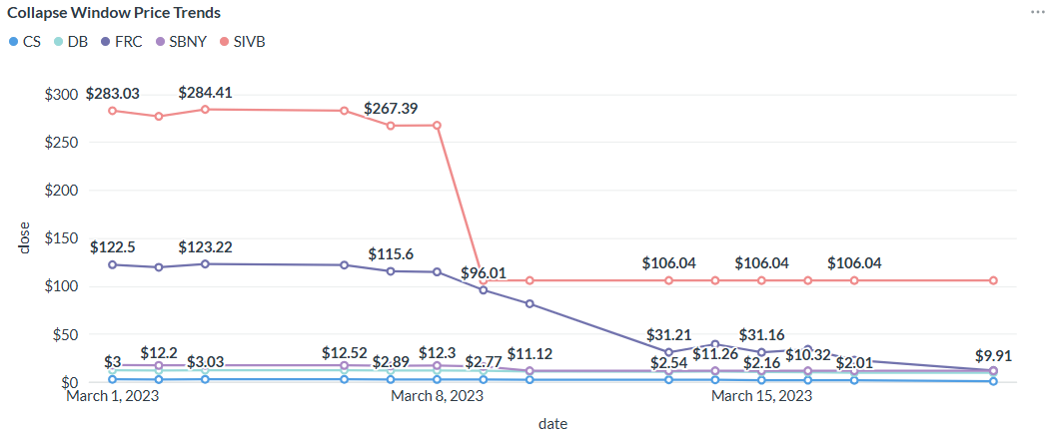
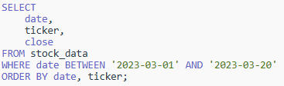
Metabase Results – Collapse Window Price Trends
Chart looks at all 5 banks during Collapse Window
CS, DB (International)
FRC, SBNY, SIVB (Regional)
Shows the magnitude of SVB’s collapse.
Same timeframe of when customers rapidly withdrew funds.
Query used in Metabase to create visual

Slide 16
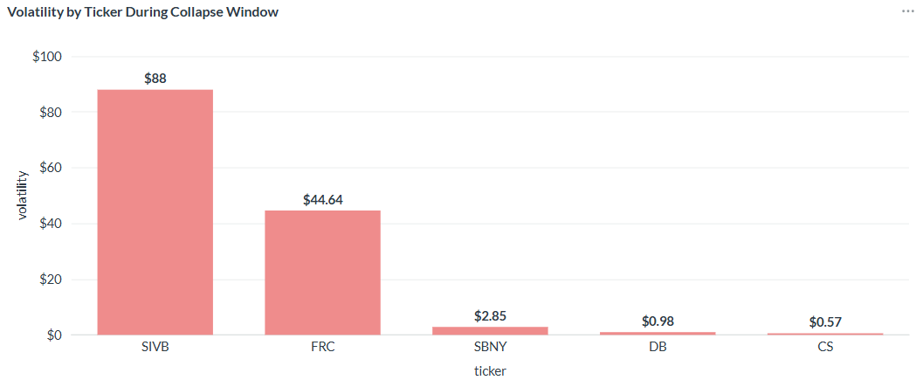
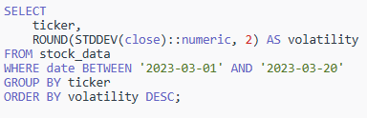
Metabase Results – Volatility by Ticker
Chart shows Volatility by Ticker
SVB has nearly double the volatility compared to 2nd place (First Republic Bank)
Measures volatility as the standard deviation of the stock’s closing price.
During Collapse Window (March 8th-13th, 2023)
Higher volatility = higher price fluctuation.
Query used in Metabase to create visual

Slide 17
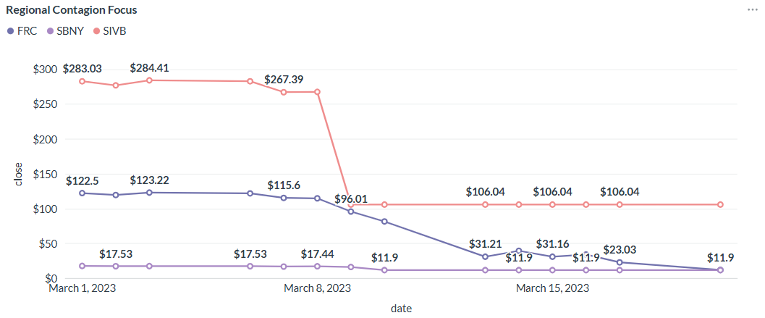
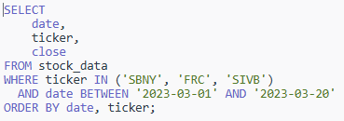
Metabase Results – Contagion Focus
This chart compares banks regional to Silicon Valley Bank.
Signature Bank
First Republic Bank
Clear decreases in FRC and SBNY as SVB drops.
Could be multiple things:
Reactions to interest rates
Investors losing confidence and pulling funds as SVB collapsed.
Query used in Metabase to create visual

Slide 18
Conclusion
SVB’s collapse was driven by:
Interest Rate Exposure
Liquidity Risk
Loss of investor/customer confidence
SVB’s example demonstrates how quickly instability can spread in banking
Highlights the importance of proactive risk management.

